Slide 1
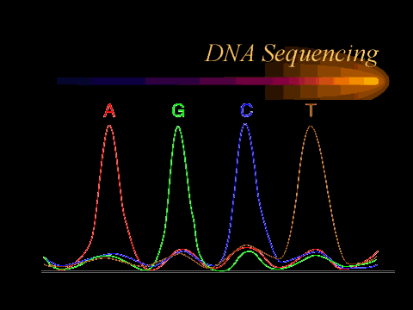
BENG 183
Trey Ideker
Genetics 101: The Basis of Genome Association
Selected slides courtesy Jim Stankovich and Hector Corrada Bravo

Slide 2
Review of Mendelian genetics
Gregor Mendel analyzed the patterns of inheritance of seven pairs of contrasting traits in the domestic pea plant. As an example pair:
P1: He mated a plant that was homozygous for round (RR) yellow (YY) seeds with one that was homozygous for wrinkled (rr) green (yy) seeds.
F1: All the offspring were dihybrids, i.e., heterozygous for each pair of alleles (RrYy).
All seeds were round and yellow, showing that the genes for round and yellow are dominant.

Slide 3
Mendelian genetics (2)
F2: Mendel then crossed the RrYy dihybrids.
If round seeds must always be yellow and wrinkled seeds must be green (linked genes), then this would have produced a typical monohybrid cross →→→
But in fact, the F2s had seeds with all combinations:
Round-yellow 9/16 Round-green 3/16 Wrinkled-yellow 3/16 Wrinkled-green 1/16
 | RY | ry
RY | RRYY | RrYy
ry | RrYy | rryy

Slide 4
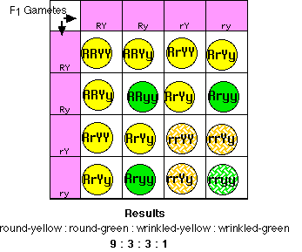
Recombinants
Recombinants
Percentage of recombinants = 50%

Slide 5
Mendel’s Rule of Independent Assortment
The inheritance of one pair of factors (genes) is independent of the inheritance of the other pair.
In other words, the percentage of recombinants is 50%
Today, we know that this rule holds only if one of two conditions is met:
The genes are on separate chromosomes
The genes are widely separated on the same chromosome.
Mendel was lucky in that every pair of genes he studied met one requirement or the other!!!
In fact, the rule does not apply to many matings of dihybrids. In many cases, two alleles inherited from one parent show a strong tendency to stay together as do those from the other parent.
This phenomenon is called linkage.

Slide 6
Genetic distance in centiMorgans
The percentage of recombinants formed by F1 individuals can range from 0-50%.
0% is seen if two loci map to the same gene.
50% is seen for two loci on separate chromosomes (independent assortment).
Between these extremes, the higher the percentage of recombinants, the greater the genetic distance separating the two loci.
The percent of recombinants is arbitrarily chosen as the genetic distance in centimorgans (cM), named for the pioneering geneticist Thomas Hunt Morgan.

Slide 7
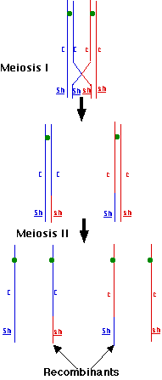
Genetic recombination is due to the physical process of crossing-over
Mating occurs AFTER all of this

Slide 8
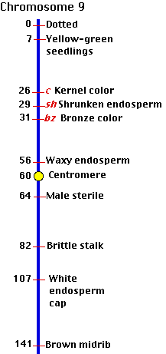
Genetic Maps
Chromosome maps prepared by counting phenotypes are called genetic maps.
Maps have been prepared for many eukaryotes, including corn, Drosophila, the mouse, and tomato.
Controlled matings are not practicable in humans, but map positions are estimated by examining family trees (pedigrees)
A genetic map of chr. 9 of the corn plant (Zea mays) is shown on the right with distances in cM.
Note distances >50cM. How?

Slide 9
Example
Corn plants are scored for three traits: C/c colored/colorless seeds Bz/bz bronze/non-bronze stalk Sh/sh Smooth/shrunken
The following F1 heterozygote self-crosses are performed:
What does the genetic map look like?
(C/c; Bz/bz) | X | (C/c; Bz/bz) | 4.6 cM
(Sh/sh; C/c) | X | (Sh/sh; C/c) | 2.8 cM
Gather more data– now can the map be determined?
(Sh/sh; Bz/bz) | X | (Sh/sh; Bz/bz) | 1.8 cM

Slide 10
Problems with genetic maps
Recombination frequency underestimates genetic distance for larger distances, due to higher order cross-over events, i.e. double and triple crossovers between markers This is overcome with 3 pt. mapping (homework)
The probability of a crossover is not uniform along the entire length of the chromosome.
Crossing over is inhibited in some regions (e.g., near the centromere).
Some regions are "hot spots" for recombination (for reasons that are not clear). Approximately 80% of genetic recombination in humans is confined to just one-quarter of our genome.
In humans, the frequency of recombination of loci on most chromosomes is higher in females than in males. Therefore, genetic maps of female chromosomes are longer than those for males.
Notes:
http://users.rcn.com/jkimball.ma.ultranet/BiologyPages/T/ThreePointCross.html
Homework is at http://users.rcn.com/jkimball.ma.ultranet/BiologyPages/T/ThreePointCross.html

Slide 11
Genetic vs. physical maps
The loci in genetic maps are simply parts of the DNA molecule that create the observed phenotype.
Knowing the DNA sequence (or at least the ordering of contigs) directly gives the order/spacing of genes.
Maps drawn in this way are called physical maps.
As a very rough rule of thumb, 1 cM genetic distance ~ 1 MB of DNA.

Slide 12
Gene linkage mapping
Tries to find a common inheritance pattern between a chromosomal region/marker and a disease phenotype
Requires genotyping on large, multigeneration pedigrees
Coarse mapping with sparse markers <10 Mb
At greater distances linkage generally does not occur due to frequent recombination events
At lesser distances all loci are typically linked and thus are indistinguishable from one another

Slide 13
Linkage analysis in a 3 generation pedigree
Solid red indicates the disease phenotype; dot means carrier
The gel is the result of RFLP analysis—note variants 1 and 2
Is this a recessive or dominant gene? Autosomal or sex linked?
What is the penetrance? This is Pr(disease phenotype | disease genotype)

Slide 14
Autosomal dominant linkage
RFLP: 1/1
2/2
Disease
No Disease
1/2
2/2
1/2
1/2
2/2
2/2
2/2
2/2
1/2
2/2
2/2

Slide 15
Computing a Log Odds (LOD) score
From the last slide: 3 affected offspring carry RFLP1, while 1 affected and 5 unaffected offspring do not carry it.
If the two loci (RFLP1 and the disease gene) are unlinked, the probability of the above observation is (0.5)⁹ = 0.002
If the two loci are in fact linked and the chance of crossover is 10% (called the recombination fraction), the probability of the observed pattern of disease is (0.9)⁸(0.1)¹ = 0.04
For each individual we are computing: Pr(D|Model) = Pr(disease state | RFLP1 state ^ linkage) Pr(D|Random) = Pr(disease state | RFLP1 state ^ non-linkage)

Slide 16
Computing a LOD score
In the prev. example the LOD score is log₁₀(0.04 / 0.002) = 1.3
A LOD > 3.0 is generally considered significant
Alternatively, parametric analysis models modes of inheritance (domnt,recssv,x-linked,etc.)

Slide 17
Table of LOD scores
If recombination fraction is unknown, optimize this parameter
 | Recombination Fraction (%)
 | 0 | 10 | 20 | 30 | 40
Family A | 2.7 | 2.3 | 1.8 | 1.3 | 0.7
Family B | -∞ | 1.0 | 0.9 | 0.6 | 0.3
Total | -∞ | 3.3 | 2.7 | 1.9 | 1.0
Box 12.1 from Primrose and Twyman

Slide 18
Gene association mapping
Also looks at common inheritance but in populations of unrelated individuals – No pedigrees required
Fine mapping with dense markers at least every 60 kb
Beyond this distance loci are generally in linkage equilibrium
Also called Linkage Disequilibrium mapping
Can be used in conjunction with the coarser grained map of linkage analysis
Can also be used alone with a genome-wide map of markers, this is called Genome-Wide Association Analysis (GWAS)

Slide 19
How to conduct a GWAS
Obtain DNA from people with disease of interest (cases) and unaffected controls.
Run each DNA sample on a SNP chip to measure states of ~1,000,000 SNPs.
Identify SNPs where one allele is significantly more common in cases than controls.
We say this SNP is associated with disease.
What are some interpretations of this?

Slide 21
Haplotype mapping
A haplotype is a pattern of SNPs in a contiguous stretch of DNA
Due to linkage disequilibrium, SNPs are typically inherited in discrete haplotype blocks spanning 10-100kb
Greatly simplifies LD analysis, because rather than screen all SNPs in a region, we just need to screen a few and the rest can be inferred
A complete human haplotype map is still underway, but the latest is available in the HapMap project

Slide 22
Example haplotype map
Figure 12.4 from Primrose and Twyman

Slide 23
LD mapping elucidates our evolutionary origins
In Northern European populations, LD extends for ~60kb
In a Nigerian African population, LD extends for ~5kb, a much shorter distance
What do we conclude from these findings?

Slide 27
Logistic Regression
The log odds is also called the logit function.
The logistic function is the inverse logit:

Slide 28
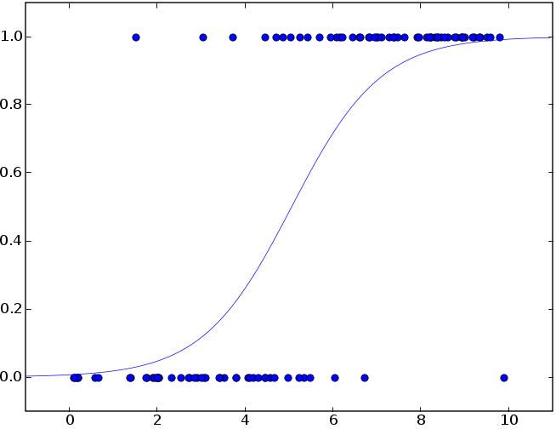
P
The input is z and the output is ƒ(z). The logistic function is useful because it can take as an input any value from negative infinity to positive infinity, whereas the output is confined to values between 0 and 1. The variable z represents the exposure to some set of independent variables, while ƒ(z) represents the probability of a particular outcome, given that set of explanatory variables.
x₁

Slide 29
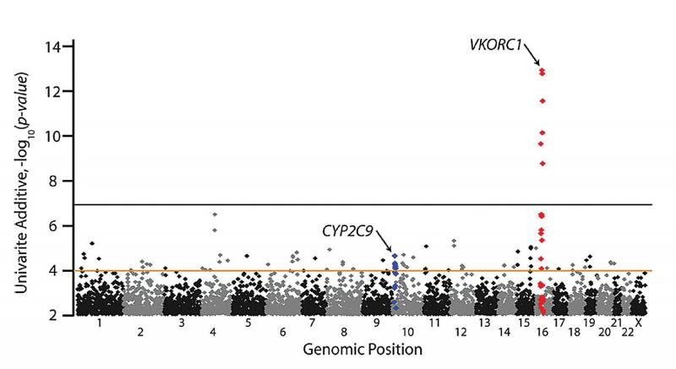
A GWAS for Warfarin Response
Cooper GM, et al., “A genome-wide scan for common genetic variants with a large influence on warfarin maintenance dose,” Blood 112: 1022-1027 (2008).

Slide 30
WHAT MIGHT BE THE PROBLEM?

Slide 32
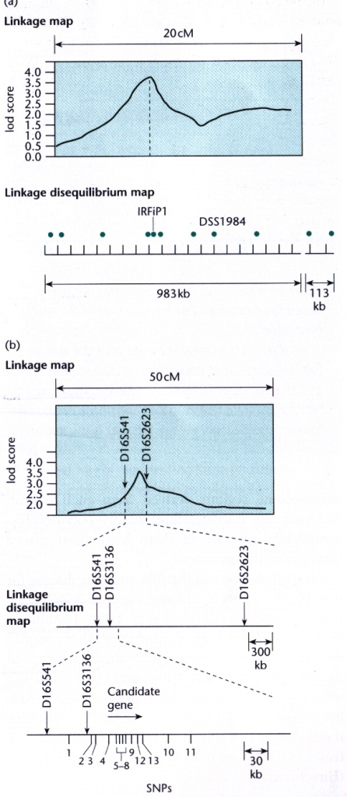
Linkage and LD analysis in tandem
Figure 12.2 from Primrose and Twyman

Slide 33
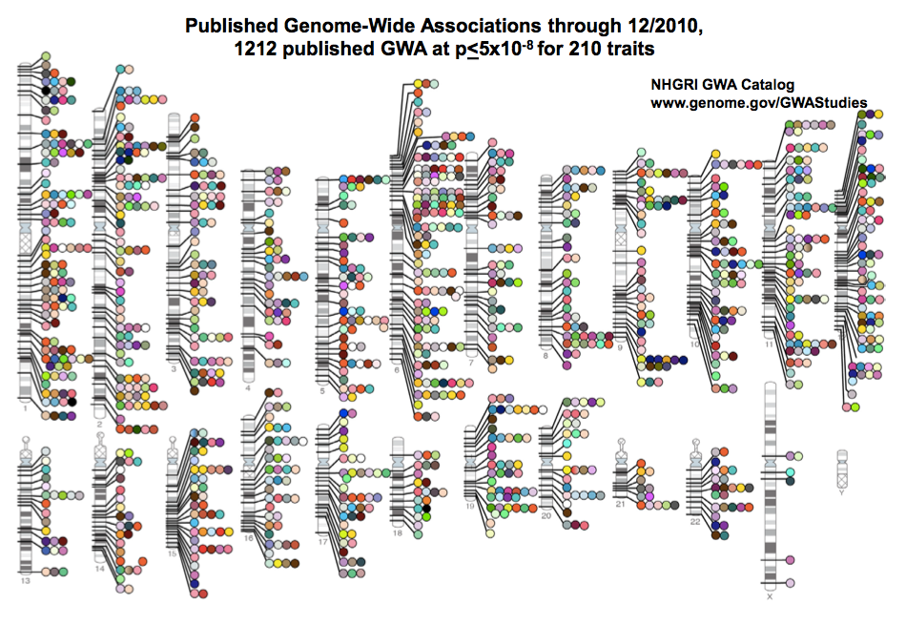

Slide 34
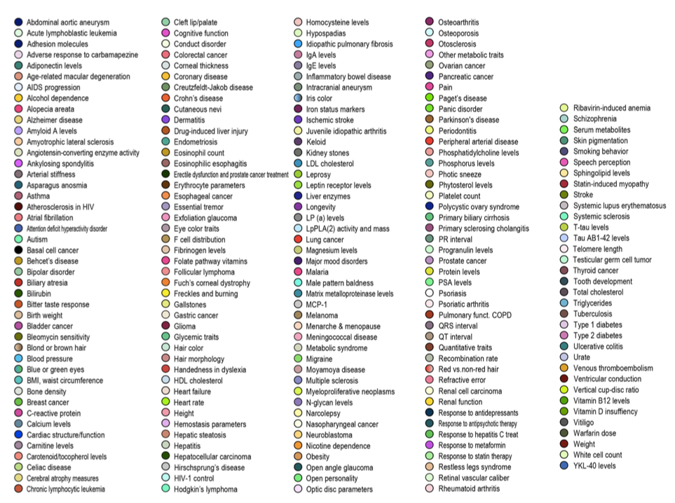

Slide 36
Sensitivity, specificity, odds ratio, likelihood ratio, and all that…

